Slide 1
Gas Absorption in a Packed Bed
Group #3
Rishabh S. Patel, Miguel Piza, Kyle Hankosky, Khoa Nguyen, Alexis Guillen
Final Lab
04/21/26

Slide 2
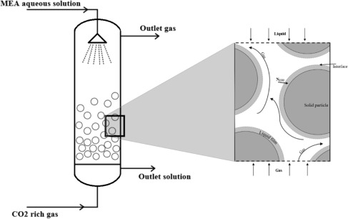
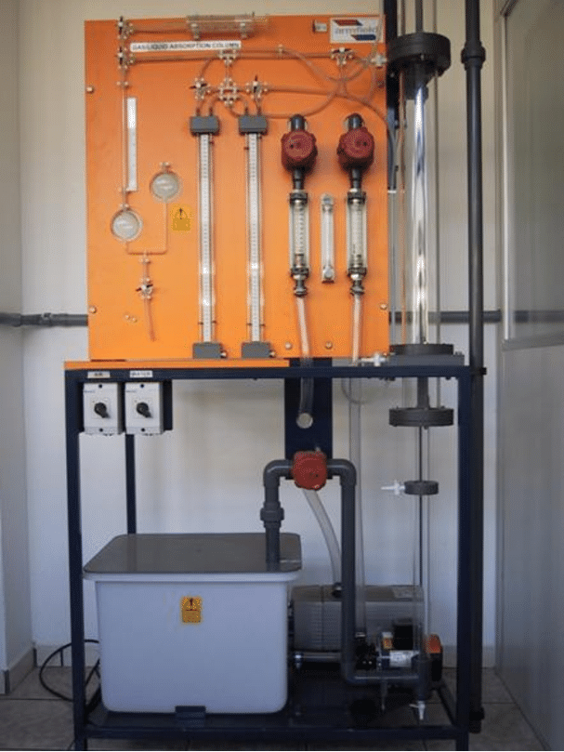
Introduction
Purpose
Measure gas and liquid flow behavior in a packed-bed absorber.
Determine pressure-drop trends and identify the flooding point.
Observe how flow rates influence phase contact inside the bed.
Figure 1. General process layout for gas–liquid absorption showing absorber and solvent regeneration steps.
Technical Focus
Remove CO2 from an air stream using water in a countercurrent packed bed.
Estimate the overall mass-transfer coefficient for CO2 absorption and desorption.
Connect operating conditions to absorber performance and design.
Figure 2. Gas absorption column used as the laboratory-scale simulator column for gas–liquid absorption experiments, equipped for gas and liquid flow as well as pressure measurement.

Slide 3
Theory
Governing Ideas
CO2 moves from the gas phase to the liquid across the gas-liquid interface.
Countercurrent flow helps maintain a driving force through the column.
Flooding is indicated by a sharp increase in pressure drop as gas rate rises.
Key Relations
N = kaΔC
ε = Vvoid / Vtotal
Overall transport can be viewed as gas-side and liquid-side resistances in series.
Assumptions / Limitations
Mass-transfer behavior is interpreted from measured pressure drop, gas composition, and liquid CO2 concentration.
CO2 solubility depends strongly on temperature and pH, so operating conditions affect the calculated coefficients.
Packed-bed operation is typically selected below flooding; around 50% of flooding is often preferred for stable contact.

Slide 4
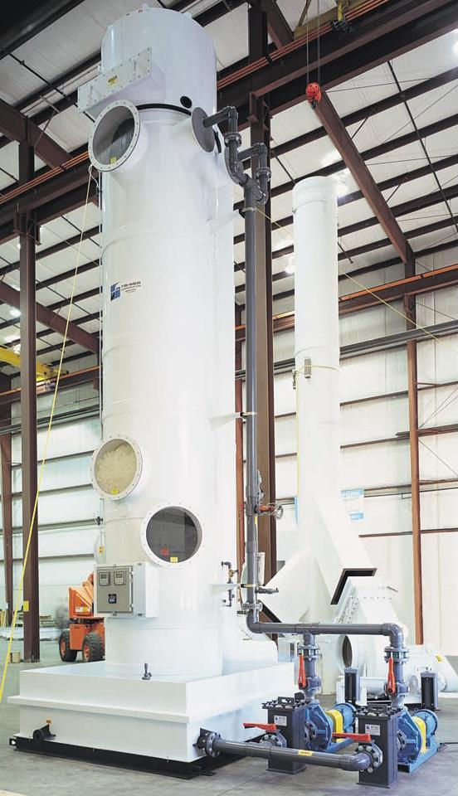
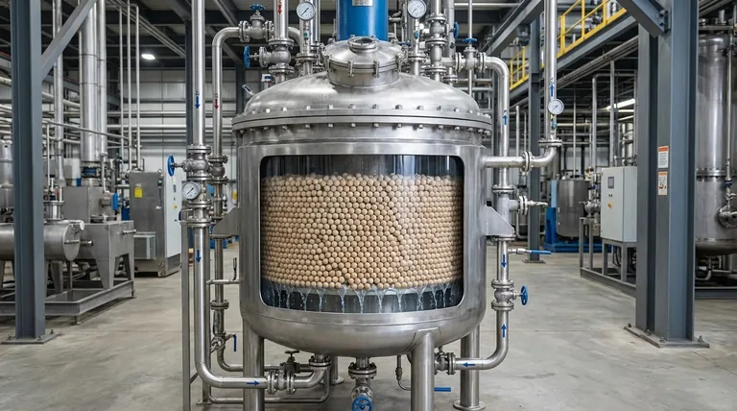
Apparatus
Industrial Applications
Packed Bed Characterization
Packed bed reactors
Gas absorbers
Packed bed scrubbers
Distillation columns
Gas Absorption
Carbon capture
Natural gas cleaning
Removes CO2
Removes H2SO4
Pollution control
Removes contaminants from waste streams
Product Recovery
Recover valuable material from gas stream
University of Michigan, “Absorbers,” Chemical Engineering Equipment Encyclopedia, 2022.
Kindle Tech, “Is a packed bed reactor the same as a fixed bed reactor?”, accessed April 2026.

Slide 5
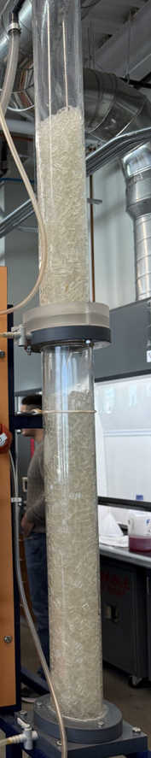
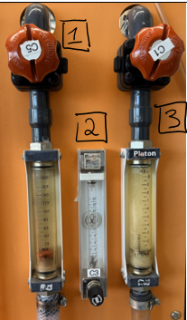
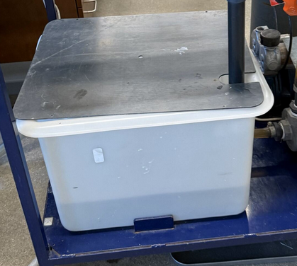
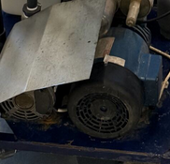
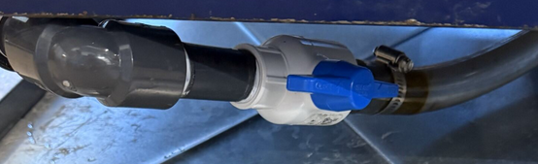
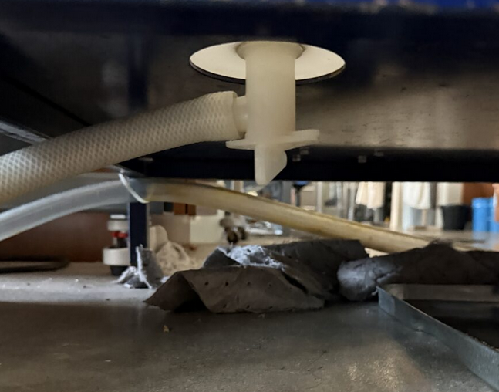
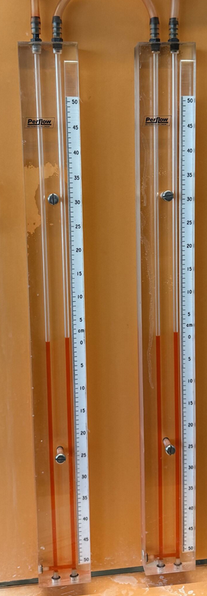
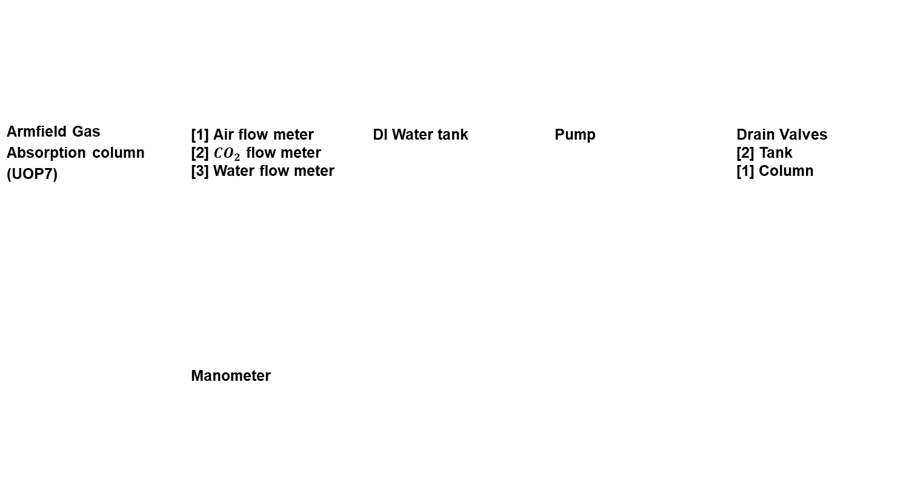
Apparatus
Armfield Gas Absorption column (UOP7) | [1] Air flow meter [2] ${CO}_{2}$ flow meter [3] Water flow meter | DI Water tank | Pump | Drain Valves [2] Tank [1] Column
 | Manometer

Slide 6
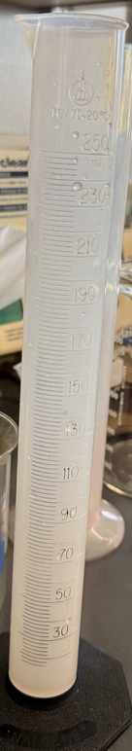
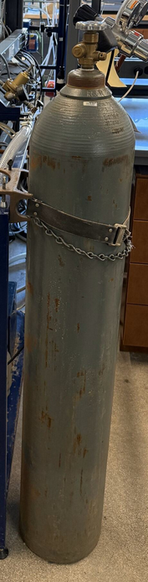
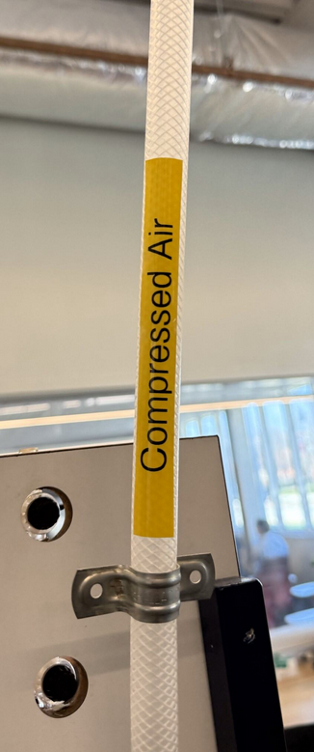
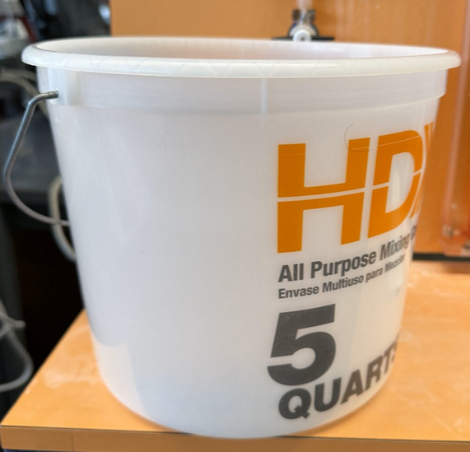
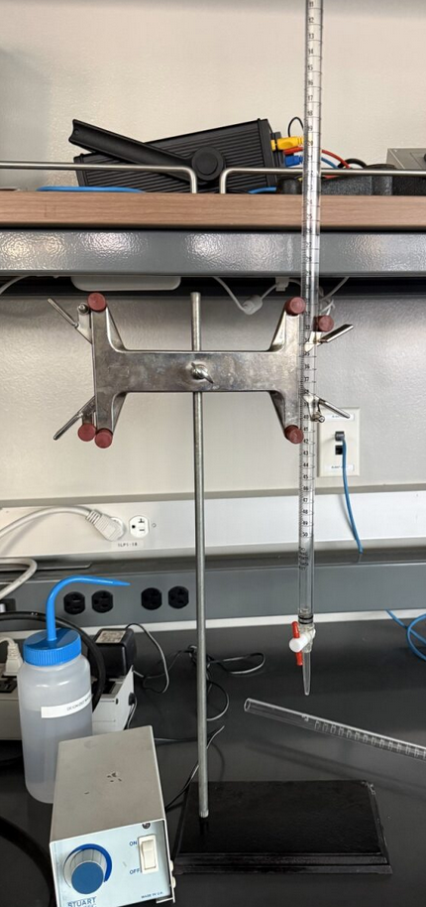
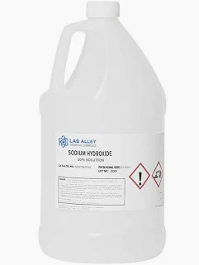


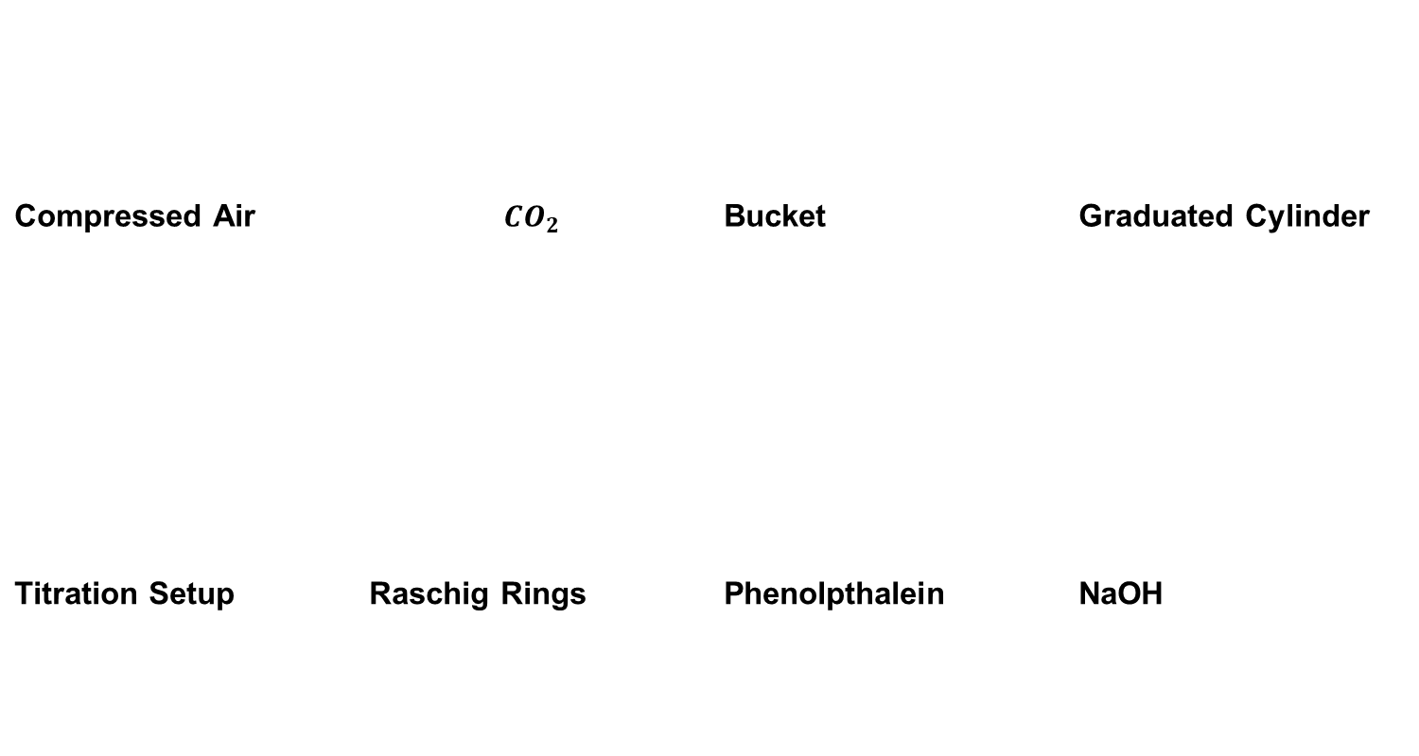
Materials
Materials
Compressed Air | $${CO}_{2}$$ | Bucket | Graduated Cylinder
Titration Setup | Raschig Rings | Phenolpthalein | NaOH

Slide 7
Procedure
Procedure
Packed bed charactericzation
Measure void fraction
Vary air and water flowrate
Record pressure drop vs gas flowrate
Identify the flooding point
Closed Loop
Run system with continuous water in/out flow
Start CO2 and air flow
Measure CO2 in water(titration)
Measure CO2 in gas(Hempl apparatus)
Continue until equilibrium
Stop CO2 flow(desorption)
Open Loop
Operate with continuous water feed
Maintain water flow constant with draining
Introduce air and CO2
Collect water at set time intervals
Measure CO2 concentrations(Titration)
Continue until steady state
Titration
Collect 50mL samples
Use phenolphthalein indicator
Titrate using NAOH

Slide 8
Data
Data
Flooding
Slow increase for low water flow
At flooding for higher flow
Pressure drop
Pressure drop increased as gas flowrate increased.
The increase was gradual across the range tested.

Slide 9
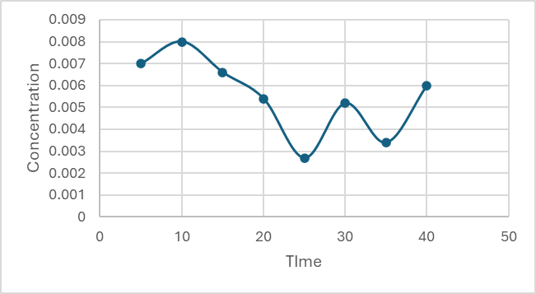
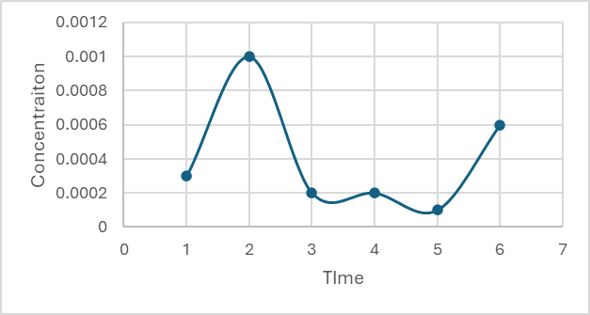
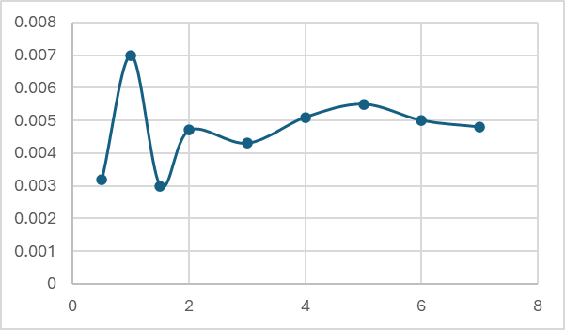
Data
Data
EXP 2A
EXP 2B
EXP 3
Operating Condition | Mass Transfer Coefficient
Closed-loop Absorption (2a) | 0.3674
Desorption (2b) | 0.861
Open-Loop Absorption (3) | 0.00535

Slide 10
Experimental Challenges
Operating Issues
Air flow tends to drift, so flowmeters and pressure readings must be checked often.
The liquid level has to remain above S4 but below the air inlet tube.
Near flooding, pressure rises rapidly and can push manometer oil into the tubing.
Measurement Issues
Sample lines for S2 and S4 should be purged before collecting data.
The Hempl analysis must be done slowly to avoid drawing liquid into the syringe.
Titration timing and endpoint judgment affect dissolved CO2 measurements.
Lessons Learned
• Stable valve settings, careful level control, and fast but consistent sampling improve data quality.

Slide 11
Safety
Chemical Safety
Review the MSDS for NaOH and phenolphthalein before starting.
Wear nitrile gloves when handling NaOH solutions.
NaOH on wet glassware can make surfaces very slippery.
Clean glassware
Gas & Equipment
Follow high-pressure cylinder safety requirements for compressed air and CO2.
Open regulators and valves slowly and verify line pressure.
Watch the manometer near flooding to avoid expelling red oil into the tubing.
Good Practice
Use gloves and goggles when handling 1.0 N NaOH.
Keep sample handling controlled and clean to reduce exposure and spills.
Place titration waste in the designated waste bottles.

Slide 12

Thank you slide
THANK YOU!

